Slide 1
Swing

Slide 2
Introduction
Swing is a part of Java Foundation Classes and it is used to Create a window based applications.
It is built on the top of AWT(Abstract Windowing Toolkit) API.
Platform Independent and Lightweight Components.
Package – javax.swing
Swing package provides classes for java swing API (i.e JButton, JTextfield, JTextArea, JRadioButton,Jcheckbox,Jmenu,JColorChooser etc.

Slide 3
Difference between AWT and Swing
 | AWT | Swing
Platform Dependency | AWT components are platform-dependent, which means they rely on the native platform's components. This can sometimes lead to inconsistencies in the look and feel across different operating systems. | Swing, on the other hand, is built on top of AWT but provides its own set of lightweight components. These components are consistent across different platforms, offering a more unified look and feel.
Component Nature | AWT components are heavyweight, meaning they are implemented using native components of the underlying platform. This can result in better integration with the platform but may lead to slower performance. | Swing components are lightweight and are entirely written in Java. They are not dependent on the underlying platform's native components, which can lead to improved performance and a more consistent appearance.
Look and Feel | The look and feel of AWT components are determined by the native windowing system, so they may vary between platforms. | Swing provides a pluggable look and feel, allowing developers to choose a specific look and feel for their application. This enables developers to create a consistent appearance across different platforms.
Customization | AWT provides a basic set of components, and customization options are limited. | Swing offers a more extensive set of components, and they are highly customizable. Developers can create their own custom components and define their appearance and behavior.
Complexity | AWT is considered simpler and easier to learn for beginners. It provides a smaller set of components compared to Swing. | Swing is more feature-rich and provides a wider range of components, making it more powerful but potentially more complex for beginners.
Thread Safety | AWT is not inherently thread-safe, and care must be taken when updating GUI components from multiple threads. | Swing is designed to be more thread-safe, and it provides mechanisms for handling events on the event dispatch thread, which is crucial for avoiding concurrency issues in GUI applications.

Slide 4
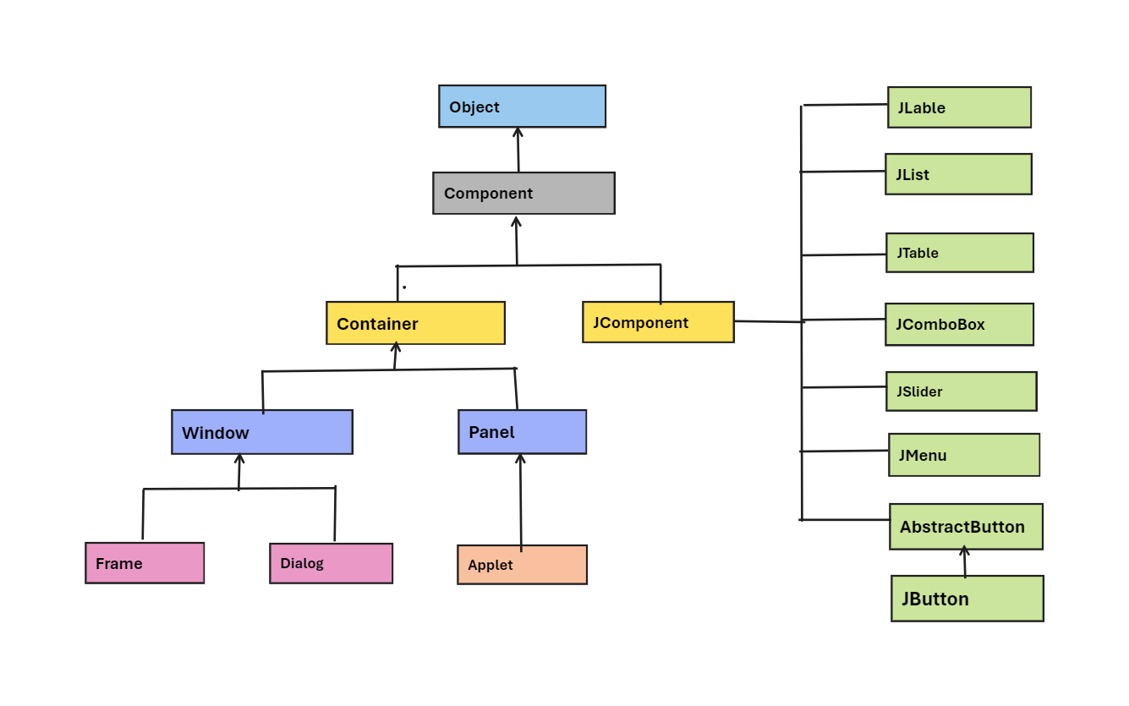
JFC
The Java Foundation Classes (JFC) are a set of GUI components which simplify the development of desktop applications.

Slide 5
EventListener
Event listeners represent the interfaces responsible to handle events.
Java provides various Event listener classes, Which are most frequently used.
Every method of an event listener method has a single argument as an object which is the subclass of Event Object class.
A button has a method called addActionListener that allows an object to register as an action listener for the button. When the button is clicked, it fires an action event and notifies all the registered action listeners by calling their actionPerformed method.

Slide 6
Event Interface
It is a marker interface which every listener interface has to extend. This class is defined in java.util package.
Event Listeners in swing typically extend sub interfaces of “EventListener” to handle specific types of event.

Slide 7
Class Declaration
Package - java.util.EventListener interface.
Syntax:
public interface EventListener

Slide 8
Swing EventListener Interface
S.No | Class | Description
1. | ActionListener | Used to Receiving the Component events (Example: Button Clicks)
2. | ComponentListener | Used to receiving the component events
3. | ItemListener | Used to receiving the item events.(Example : using Radio button and Check box ).
4. | KeyListener | Used to receiving the key events
5. | MouseListener | Used to receiving the MouseListener. (Example : Mouse Clicks and Movements)
6. | WindowListener | Used to receiving the windows events.
7. | AdjustmentListener | Used to receiving the adjustment Events.
8. | ContainerListener | Used to receiving Container Events
9. | MouseMotionListener | Used to receiving the mouse Motion events.

Slide 9
JButton
The JButton class is used to create a labeled button that has platform independent implementation.
The application result in some action when the button is pushed.
It inherits AbstractButton class.
JButton Declaration:
javax.swing.Jbutton
Syntax:
public class JButton extends AbstractButton implements Accessible

Slide 10
Constructors in JButton
Constructor | Description
JButton() | It creates a button with no text and icon.
JButton(String s) | It creates a button with the specified text.
JButton(Icon i) | It creates a button with the specified icon object.

Slide 11
Methods for AbstractButton class:
Methods | Description
addActionListener(ActionListener listener) | Adds an ActionListener to the button. The actionPerformed method of the listener will be invoked when the button is clicked.
doClick() | Simulates a button click. This method can be used to programmatically trigger the button's action without actual user interaction.
setAction(Action a) | Sets the Action associated with this button. An Action encapsulates the behavior of the button, such as its text, icon, and enabled/disabled state
setSelected(boolean selected) | Sets the selected state of the button. This is relevant for components like JToggleButton and JCheckBox
isSelected() | Returns true if the button is selected, false otherwise.
setModel(ButtonModel newModel) | Sets the button model. The ButtonModel represents the internal data model of the button, including its state and appearance.
getModel() | Returns the button model associated with the button.
setText(String text) | Sets the text of the button.
getText() | Returns the text of the button.
setIcon(Icon defaultIcon) | Sets the default icon for the button.
getIcon() | Returns the default icon of the button.
setMnemonic(int mnemonic) | Sets the mnemonic for the button. The mnemonic is a keyboard shortcut that activates the button when pressed in combination with a modifier key (such as Alt).

Slide 12
JButton Example program:
import javax.swing.*;
public class ButtonExample {
public static void main(String[] args) {
JFrame f=new JFrame("Button Example");
JButton b=new JButton("Click Here");
b.setBounds(50,100,95,30);
f.add(b);
f.setSize(400,400);
f.setLayout(null);
f.setVisible(true);
}
}

Slide 13
Example program for JButton Action Listener
import java.awt.event.*;
import java.awt.event.ActionListener;
import javax.swing.JButton;
import javax.swing.JFrame;
public class SwingEventListener {
public static void main(String[] args) {
JFrame frame = new JFrame("Swing Event Listener Example");
frame.setDefaultCloseOperation(JFrame.EXIT_ON_CLOSE);
frame.setSize(300, 200);
JButton button = new JButton("Click Here");// Create a JButton
ActionListener actionListener = new ActionListener() {// Create an ActionListener for the button
public void actionPerformed(ActionEvent e) {
System.out.println("Well Done!");// This method is called when the button is clicked
ystem.out.println("Action Performed");
}};
button.addActionListener(actionListener);// Add the ActionListener to the button
frame.getContentPane().add(button);// Add the button to the frame
frame.setVisible(true);// Set the frame to be visible
}}

Slide 14
JLabel
The JLabel class is used to display a non-editable text or image. It is commonly used to add descriptive text or images to a GUI
Package
javax.swing.Jlabel.
Syntax:
public class JLabel extends JComponent implements SwingConstants, Accessible

Slide 15
Constructors
Constructors | Description
Label() | Creates a JLabel instance with no image and with an empty string for the title.
JLabel(String s) | Creates a JLabel instance with the specified text.
JLabel(Icon i) | Creates a JLabel instance with the specified image.
JLabel(String s, Icon i, int horizontalAlignment) | Creates a JLabel instance with the specified text, image, and horizontal alignment.

Slide 16
Methods in JLabel:
Methods | Description
String getText() | It returns the text string that a label displays.
void setText(String text) | It defines the single line of text this component will display.
void setHorizontalAlignment(int alignment) | It sets the alignment of the label's contents along the X axis.
Icon getIcon() | It returns the graphic image that the label displays.
int getHorizontalAlignment() | It returns the alignment of the label's contents along the X axis.

Slide 17
Example program for JLabel:
import java.awt.Font;
import javax.swing.JFrame;
import javax.swing.JLabel;
public class JLabelExample {
public static void main(String args[]) {
JFrame frame = new JFrame("JLabel Example");
frame.setDefaultCloseOperation(JFrame.EXIT_ON_CLOSE);
frame.setSize(300, 200);
JLabel label = new JLabel("Hello, Swing!");// Create a JLabel with text
Font labelFont = new Font("Arial", Font.PLAIN, 18);// Set font for the label (optional)
label.setFont(labelFont);
frame.getContentPane().add(label);// Add the label to the frame
frame.setVisible(true);// Set the frame to be visible
}
}

Slide 18
JTextField
The object of a JTextField class is a text component that allows the editing of a single line text. It inherits JTextComponent class.
Package:
javax.swing.JTextField
Syntax:
public class JTextField extends JTextComponent implements SwingConstants

Slide 19
Constructors
Constructor | Description
JTextField() | Creates a new TextField
JTextField(String text) | Creates a new TextField initialized with the specified text.
JTextField(String text, int columns) | Creates a new TextField initialized with the specified text and columns.
JTextField(int columns) | Creates a new empty TextField with the specified number of columns.

Slide 20
Methods
Methods | Description
void addActionListener(ActionListener l) | It is used to add the specified action listener to receive action events from this textfield.
Action getAction() | It returns the currently set Action for this ActionEvent source, or null if no Action is set.
void setFont(Font f) | It is used to set the current font.
void removeActionListener(ActionListener l) | It is used to remove the specified action listener so that it no longer receives action events from this textfield.

Slide 21
Example Program for JTextfield:
import javax.swing.*;
class TextFieldExample
{
public static void main(String args[])
{
JFrame f= new JFrame("TextField Example");
JTextField t1,t2;
t1=new JTextField("Welcome to Javatpoint.");
t1.setBounds(50,100, 200,30);
t2=new JTextField("AWT Tutorial");
t2.setBounds(50,150, 200,30);
f.add(t1); f.add(t2);
f.setSize(400,400);
f.setLayout(null);
f.setVisible(true);
}
}

Slide 22
Example program for JTextfield with ActionListener
import javax.swing.*;
import java.awt.event.ActionEvent.*;
public class JLabelExample {
public static void main(String[] args) {
JFrame frame = new JFrame("JTextField Example");// Create a JFrame (window)
frame.setDefaultCloseOperation(JFrame.EXIT_ON_CLOSE);
frame.setSize(400, 200);
JTextField textField = new JTextField();// Create a JTextField
textField.setBounds(10, 10, 200, 30);
JButton submitButton = new JButton("Submit"); // Create a JButton to perform an action
submitButton.setBounds(220, 10, 80, 30);
JLabel resultLabel = new JLabel("Result:");// Create a JLabel to display the entered text
resultLabel.setBounds(10, 50, 300, 30);
submitButton.addActionListener(new ActionListener() {// Add an ActionListener to the button
public void actionPerformed(ActionEvent e) {
String enteredText = textField.getText();// Get the text from the text field and display it in the label
resultLabel.setText("Result: " + enteredText);
}});
frame.getContentPane().setLayout(null);// Add components to the frame
frame.getContentPane().add(textField);
frame.getContentPane().add(submitButton);
frame.getContentPane().add(resultLabel);
frame.setVisible(true);// Set the frame to be visible }}

Slide 23
JTextArea
The object of a JTextArea class is a multi line region that displays text. It allows the editing of multiple line text. It inherits JTextComponent class.
Package:
javax.swing.JTextArea
Syntax:
public class JTextArea extends JTextComponent

Slide 24
Constructor
Constructor | Description
JTextArea() | Creates a text area that displays no text initially.
JTextArea(String s) | Creates a text area that displays specified text initially.
JTextArea(int row, int column) | Creates a text area with the specified number of rows and columns that displays no text initially.
JTextArea(String s, int row, int column) | Creates a text area with the specified number of rows and columns that displays specified text.

Slide 25
Methods
Methods | Description
void setRows(int rows) | It is used to set specified number of rows.
void setColumns(int cols) | It is used to set specified number of columns.
void setFont(Font f) | It is used to set the specified font.
void insert(String s, int position) | It is used to insert the specified text on the specified position.
void append(String s) | It is used to append the given text to the end of the document.

Slide 26
Example program for JTextArea
import javax.swing.*;
public class TextAreaExample
{
TextAreaExample(){
JFrame f= new JFrame();
JTextArea area=new JTextArea("Welcome to javatpoint");
area.setBounds(10,30, 200,200);
f.add(area);
f.setSize(300,300);
f.setLayout(null);
f.setVisible(true); }
public static void main(String args[])
{
new TextAreaExample();
}}

Slide 27
JPasswordField
The object of a JPasswordField class is a text component specialized for password entry. It allows the editing of a single line of text. It inherits JTextField class.
Package:
javax.swing.JPasswordField
Syntax:
public class JPasswordField extends JTextField

Slide 28
Constructors:
Constructor | Description
JPasswordField() | Constructs a new JPasswordField, with a default document, null starting text string, and 0 column width.
JPasswordField(int columns) | Constructs a new empty JPasswordField with the specified number of columns.
JPasswordField(String text) | Constructs a new JPasswordField initialized with the specified text.
JPasswordField(String text, int columns) | Construct a new JPasswordField initialized with the specified text and columns.

Slide 29
Example program for JPasswordField
import javax.swing.*;
public class PasswordFieldExample {
public static void main(String[] args) {
JFrame f=new JFrame("Password Field Example");
JPasswordField value = new JPasswordField();
JLabel l1=new JLabel("Password:");
l1.setBounds(20,100, 80,30);
value.setBounds(100,100,100,30);
f.add(value); f.add(l1);
f.setSize(300,300);
f.setLayout(null);
f.setVisible(true);
}
}

Slide 30
JCheckBox
The JCheckBox class is used to create a checkbox. It is used to turn an option on (true) or off (false). Clicking on a CheckBox changes its state from "on" to "off" or from "off" to "on ".It inherits JToggleButton class.
Package:
javax.swing.JCheckBox
Syntax:
public class JCheckBox extends JToggleButton implements Accessible

Slide 31
Constructor
Constructor | Description
JJCheckBox() | Creates an initially unselected check box button with no text, no icon.
JChechBox(String s) | Creates an initially unselected check box with text.
JCheckBox(String text, boolean selected) | Creates a check box with text and specifies whether or not it is initially selected.
JCheckBox(Action a) | Creates a check box where properties are taken from the Action supplied.

Slide 32
Methods
Methods | Description
AccessibleContext getAccessibleContext() | It is used to get the AccessibleContext associated with this JCheckBox.
protected String paramString() | It returns a string representation of this JCheckBox.

Slide 33
Example program for JCheckBox
import javax.swing.*;
public class CheckBoxExample
{
CheckBoxExample(){
JFrame f= new JFrame("CheckBox Example");
JCheckBox checkBox1 = new JCheckBox("C++");
checkBox1.setBounds(100,100, 50,50);
JCheckBox checkBox2 = new JCheckBox("Java", true);
checkBox2.setBounds(100,150, 50,50);
f.add(checkBox1);
f.add(checkBox2);
f.setSize(400,400);
f.setLayout(null);
f.setVisible(true);
}
public static void main(String args[])
{
new CheckBoxExample();
}}

Slide 34
JRadioButton
The JRadioButton class is used to create a radio button. It is used to choose one option from multiple options. It is widely used in exam systems or quiz.
It should be added in ButtonGroup to select one radio button only.
Package:
javax.swing.JRadioButton
Syntax:
public class JRadioButton extends JToggleButton implements Accessible

Slide 35
Constructor
Constructor | Description
JRadioButton() | Creates an unselected radio button with no text.
JRadioButton(String s) | Creates an unselected radio button with specified text.
JRadioButton(String s, boolean selected) | Creates a radio button with the specified text and selected status.

Slide 36
Methods
Methods | Description
void setText(String s) | It is used to set specified text on button.
String getText() | It is used to return the text of the button.
void setEnabled(boolean b) | It is used to enable or disable the button.
void setIcon(Icon b) | It is used to set the specified Icon on the button.
Icon getIcon() | It is used to get the Icon of the button.
void setMnemonic(int a) | It is used to set the mnemonic on the button.
void addActionListener(ActionListener a) | It is used to add the action listener to this object.

Slide 37
Example Program for JRadioButton
import javax.swing.*;
public class RadioButtonExample {
JFrame f;
RadioButtonExample(){
f=new JFrame();
JRadioButton r1=new JRadioButton("A) Male");
JRadioButton r2=new JRadioButton("B) Female");
r1.setBounds(75,50,100,30);
r2.setBounds(75,100,100,30);
ButtonGroup bg=new ButtonGroup();
bg.add(r1);bg.add(r2);
f.add(r1);f.add(r2);
f.setSize(300,300);
f.setLayout(null);
f.setVisible(true);
}
public static void main(String[] args) {
new RadioButtonExample();
} }

Slide 38
JComboBox
The object of Choice class is used to show popup menu of choices. Choice selected by user is shown on the top of a menu. It inherits JComponent class.
Package:
javax.swing.JComboBox
Syntax:
public class JComboBox extends JComponent implements ItemSelectable, ListDataListener, ActionListener, Accessible

Slide 39
Constructor
Constructor | Description
JComboBox() | Creates a JComboBox with a default data model.
JComboBox(Object[] items) | Creates a JComboBox that contains the elements in the specified array.
JComboBox(Vector<?> items) | Creates a JComboBox that contains the elements in the specified Vector.

Slide 40
Methods
Methods | Description
void addItem(Object anObject) | It is used to add an item to the item list.
void removeItem(Object anObject) | It is used to delete an item to the item list.
void removeAllItems() | It is used to remove all the items from the list.
void setEditable(boolean b) | It is used to determine whether the JComboBox is editable.
void addActionListener(ActionListener a) | It is used to add the ActionListener
void addItemListener(ItemListener i) | It is used to add the ItemListener.

Slide 41
Example program for JComboBox
import javax.swing.*;
public class ComboBoxExample {
JFrame f;
ComboBoxExample(){
f=new JFrame("ComboBox Example");
String country[]={"India","Aus","U.S.A","England","Newzealand"};
JComboBox cb=new JComboBox(country);
cb.setBounds(50, 50,90,20);
f.add(cb);
f.setLayout(null);
f.setSize(400,500);
f.setVisible(true);
}
public static void main(String[] args) {
new ComboBoxExample();
}
}

